Slide 1
Energetic compensation breaks down over time in a desert rodent community
Renata M. Diaz and S. K. Morgan Ernest
ESA Annual Meeting, August 2021

Slide 2

Energetic compensation: declines or extinctions of some species are offset by increases from others, so total community energy use is maintained.
Notes:
Explain hypothetical scenario
Consistent with zero-sum competition
By definition means community function is more stable than species

Slide 3
Energetic compensation: decreases in abundance of one species are offset by increases from others, so total energy use is maintained.
When is absent, increases in abundance to use 100% of the energy left unused by .
An assemblage without uses the same amount of energy as the complete assemblage.
Notes:
Explain hypothetical scenario
Consistent with zero-sum competition
By definition means community function is more stable than species

Slide 4
When observed, energetic compensation is consistent with a zero sum competitive dynamic.
Energetic compensation renders community-level function less variable than individual species’ abundances.
Notes:
Explain hypothetical scenario
Consistent with zero-sum competition
By definition means community function is more stable than species

Slide 5
For energetic compensation to occur, some species must have identical or overlapping traits relating to both resource use and environmental tolerances.

Slide 6
Competition and compensation have an inherent temporal dimension.

Slide 7
Compensation is an inherently temporal phenomenon. Dispersal limitation can delay compensation.

Slide 8
Competition and compensation have an inherent temporal dimension. Dispersal limitation can delay compensation. Changing conditions may affect similar competitors in different ways.

Slide 9
Competition and compensation have an inherent temporal dimension. Dispersal limitation can delay compensation. Changing conditions may affect similar competitors in different ways.

Slide 10





Notes:
Explain hypothetical scenario
Consistent with zero-sum competition
By definition means community function is more stable than species

Slide 11
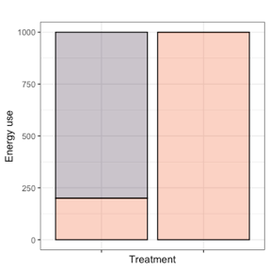
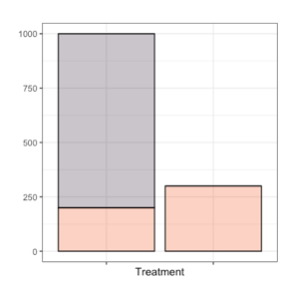
Notes:
Explain hypothetical scenario
Consistent with zero-sum competition
By definition means community function is more stable than species

Slide 12
How do changing environmental conditions modulate energetic compensation over time?

Slide 13
Long-term experiments: The Portal Project
Kangaroo rats
Excluded from experimental plots since 1977
Bailey’s pocket mouse
Established at site ~1996
Small granivores (mostly desert pocket mice)
Present since 1977

Slide 14
Strong compensation began in 1996, driven by C. baileyi ( )
1977 - 1996
1996 - 2010
16% compensation for kangaroo rat removal
Energy use on exclosures 25% of controls
52% compensation for kangaroo rat removal
Energy use on exclosures 67% of controls

Slide 15
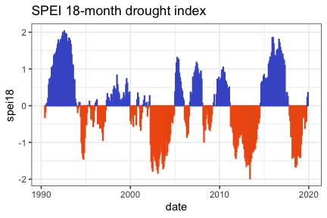
C. baileyi has declined following drought in 2010.

Slide 16
Small granivores have increased their share of community energy use.

Slide 17
How have these changes impacted energetic compensation?

Slide 18
Other small granivores may now be compensating, in place of C. baileyi
Hypothetical 2010-2020

Slide 19
Or, compensation may have broken down.
Hypothetical 2010-2020

Slide 20
Compensation has declined with C. baileyi.
Actual 2010-2020

Slide 21
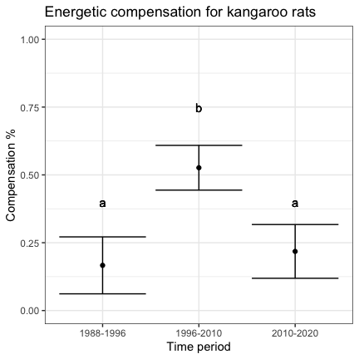
Generalized least squares accounting for temporal autocorrelation

Slide 22
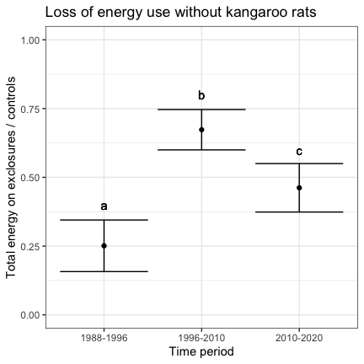
Generalized least squares accounting for temporal autocorrelation

Slide 23
Under conditions at the site from 1996-2010, C. baileyi was able to compensate for kangaroo rat removal. C. baileyi is still present, and resources are still available, but C. balieyi is no longer abundant enough to compensate for kangaroo rats. Under present conditions, additional factors limit C. baileyi and prevent compensation.

Slide 24
Under conditions at the site from 1996-2010, C. baileyi was able to compensate for kangaroo rat removal. C. baileyi is still present, and resources are still available, but C. balieyi is no longer abundant enough to compensate for kangaroo rats. Under present conditions, additional factors limit C. baileyi and prevent compensation.

Slide 25
Compensation depends not only on the species present but on their match to current environmental conditions.
As conditions change, compensation may come and go within a single assemblage.

Slide 26
Zero-sum competitive dynamics may be intermittent and contingent on changing conditions.
Compensatory dynamics fluctuate over the scale of decades.

Slide 27
Maintenance of community-level function despite species extinctions depends on both the remaining species in an assemblage and how their competitive dynamic changes as conditions shift.

Slide 28
Thank you, and I look forward to any questions!
Live discussion: Tuesday, August 2 at 2pm EST

Slide 29
Acknowledgements
NSF funding
UF
Portal Project folks

